Slide 1
Summer Olympics - Exploratory Data Analysis
Sunil Kumar Mano
GCD - June '08 batch, INSAID
Email : sunilkumarm.182@gmail.com

Slide 2
Introduction
Olympics is one of the oldest traditions in the world. In this project, we will explore certain characteristics leading to useful insights with the Summer Olympics data.
This is a historical dataset on the Summer Olympic Games, including the Games from Athens 1896 to London 2012.
This dataset provides an opportunity to ask questions about how the Olympics have evolved over time, including questions about the participation and performance of women, different nations and different sports and events.

Slide 3
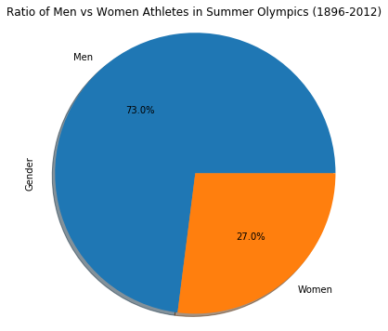
Ratio of Men vs Women Athletes
From the visualization we can able to understand that men participants are more in Summer Olympics than Women participants. Exactly, 73% are Men participants and only 27% are Women participants in the total data.

Slide 4
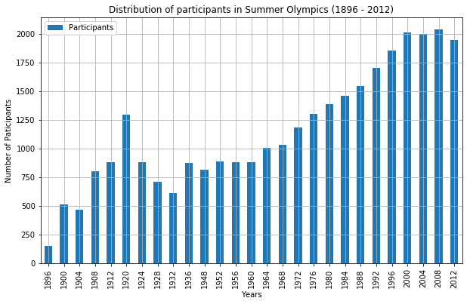
Distribution of participants
From the visualization we can able to understand that participants are lesser in the initial seasons of Summer Olympics and post 1960's the participation of athletes has gradually increased.

Slide 5
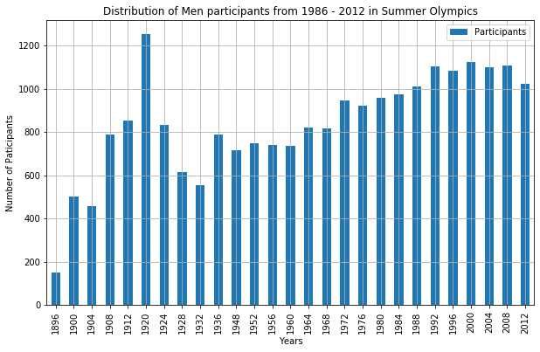
Distribution of Men participants
From the visualization we can able to understand that in the recent years the men participants count has gradually increased and in 1920 there is a sudden spike in participants count in Summer Olympics.

Slide 6
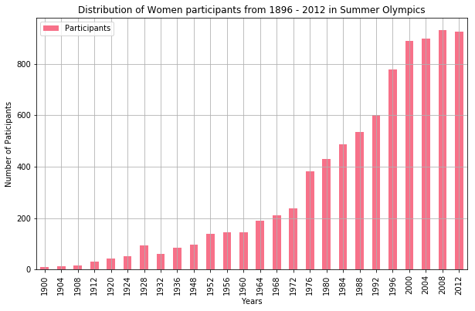
Distribution of Women participants
From the visualization we can able to understand that there was no Women participants in the initial version of Summer Olympics in 1896. After that there was tremendous increase in the Women participants in recent years.

Slide 7
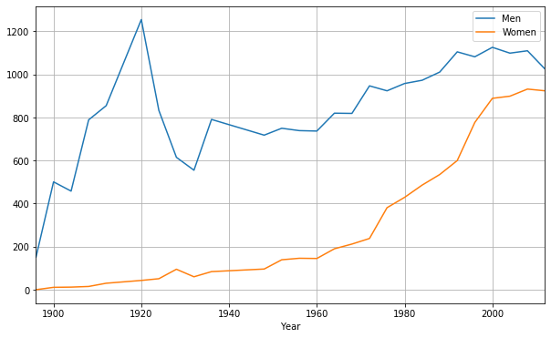
Line Chart - Men vs Women participants

Slide 8
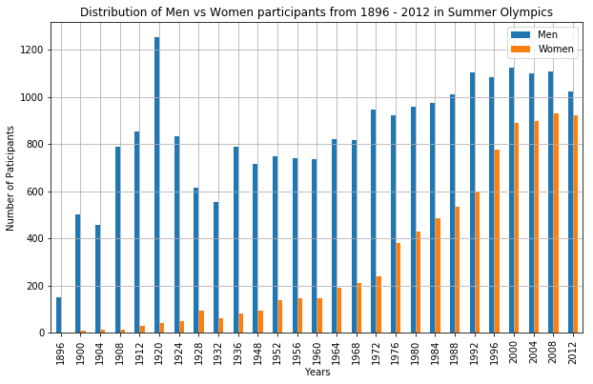
Bar chart - Men vs Women participants

Slide 9
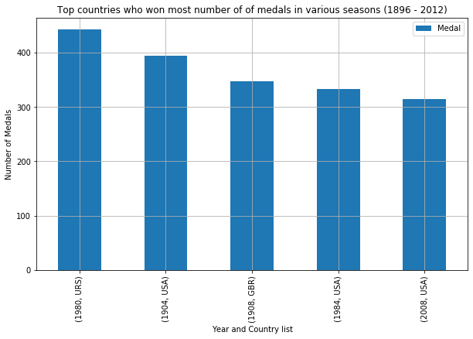
Distribution of Medals per country
From the list we can able to understand that URS - Soviet Union, GBR - Great Britain and USA - United States of America are the countries who have won the most number of medals across various seasons of Summer Olympics.

Slide 10
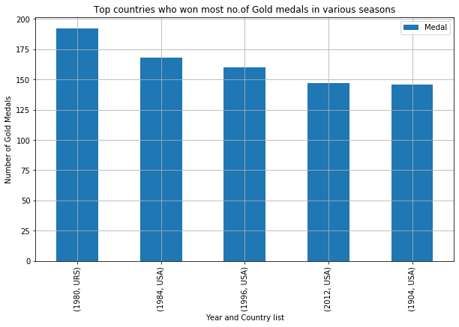
countries won most number of Gold medals
From the visualization it is pretty clear that USA has dominated in winning the Gold Medals across the various seasons of Summer Olympics 4 times and Soviet Union once.

Slide 11
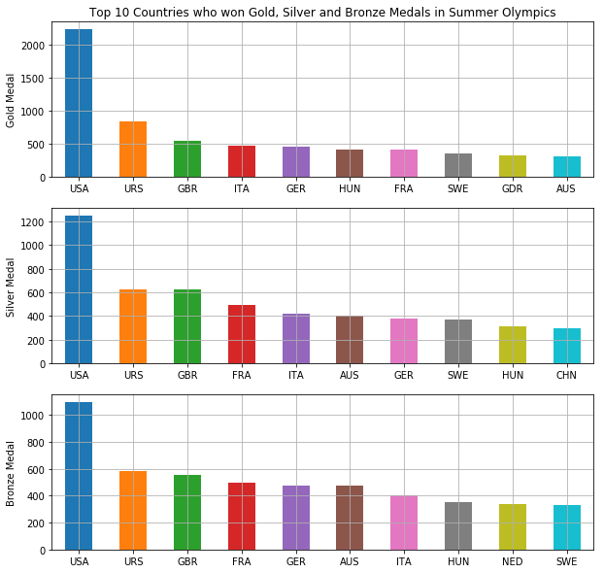
Countries vs Gold, Silver, Bronze Medals
From the visualization it is pretty clear that USA has dominated in winning the Gold, Silver and Bronze Medals across the various seasons of Summer Olympics

Slide 12
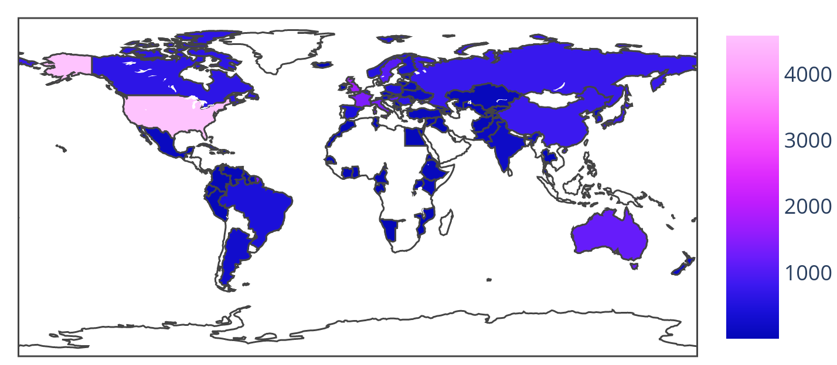
Choropleth Map - Countries vs medals

Slide 13
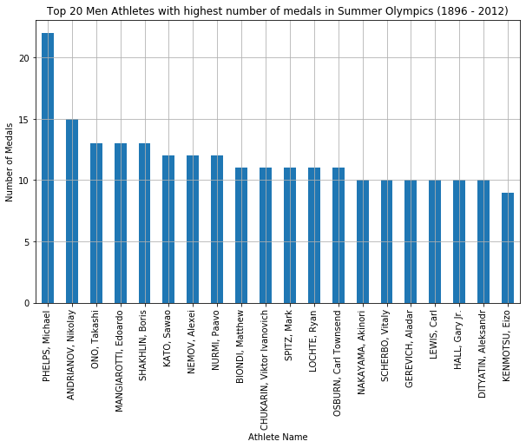
Men Athletes vs medals

Slide 14
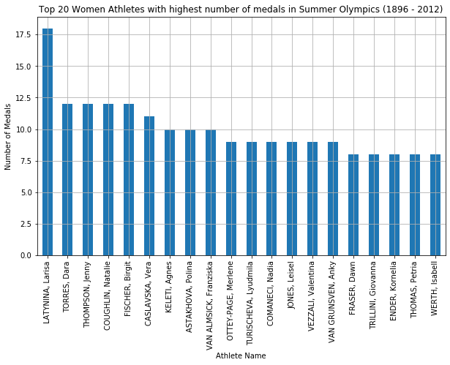
Women Athletes vs medals

Slide 15
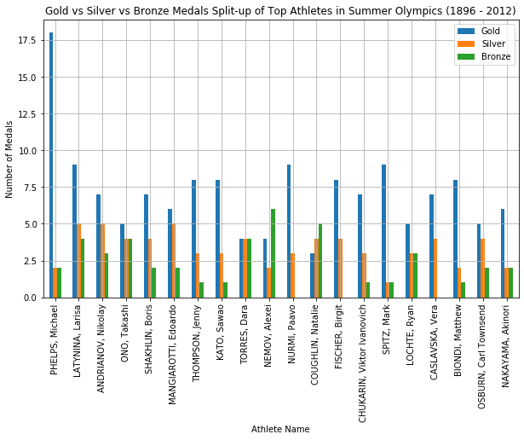
Gold, Silver, Bronze Medals of Top Athletes
Michael Phelps and Larisa Latynina are the top Athletes who won most number of medals in the Summer Olympics (1896 - 2012) and their Gold, Silver and Bronze medal counts are provided in the visualization.

Slide 16
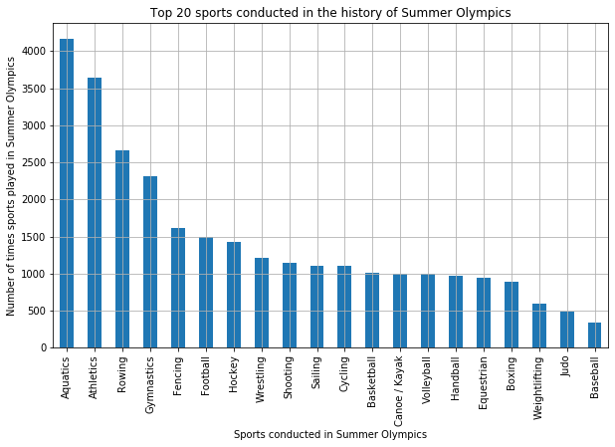
Types of Sports in Summer Olympics
From the results we can able to understand that the top sports conducted in Summer Olympics are Aquatics, Athletics, Rowing, Gymnastics etc..

Slide 17
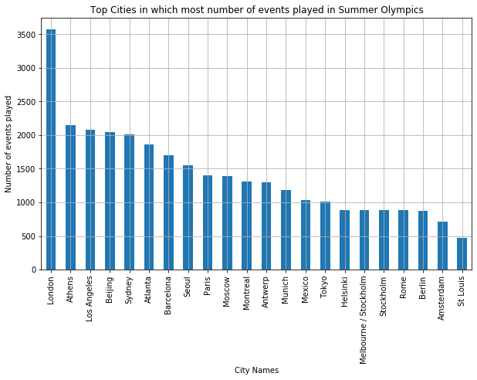
Top Cities with most number of events
From the visualization we can able to understand that London is the only city that has hosted most number of events in the Summer Olympics in 3 different seasons.

Slide 18
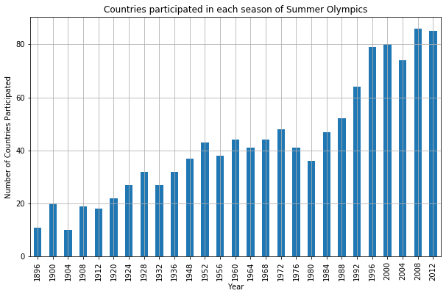
Disciplines with the Number of Countries
For the results we can able to understand that the participation of countries in Summer Olympics has gradually increased over the years and many number of countries participated in the last 2-3 decades.

Slide 19
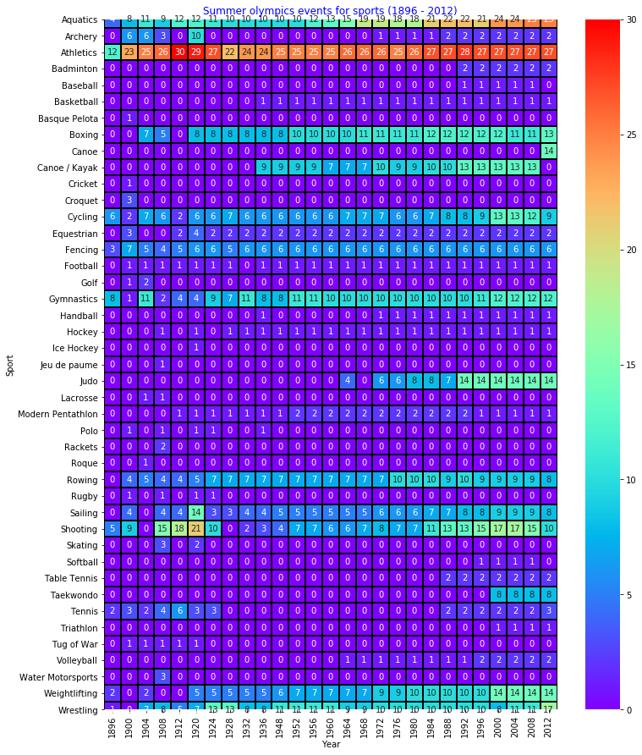
Heatmap - Number of events in each sport over the years

Slide 20
Conclusion
Women were not a very large part of the Summer Olympics contingents earlier, now enjoy equal representation in the Olympics teams.
London is the only city that has hosted Summer Olympics 3 times.
Michael Phelps and Larisa Latynina are the top Athletes who won most number of medals in the Summer Olympics (1896 - 2012).
Though USA was the dominant country in winning medals every year, it didn’t win not even a single medal in 1980. After searching in google, we found that USA didn’t participate in the 1980 Summer Olympics. Likewise, Russia didn’t win not even a single medal in 1984 because, it didn’t participated in Summer Olympics - 1984.

